Slide 1
SAP Exchange Infrastructure
2
Application Environment
Enterprise Service Repository

Slide 2

Enterprise Service Repository
Agenda
Advanced Mapping Objects - Standard functions
Context Objects
UDF

Slide 3
Standard functions
The mapping editor, provides a variety of standard functions for text mappings, arithmetic calculations, (runtime) constants, conversions, date format conversions, statistical functions for all fields of a context, and functions for special structure mappings.
Boolean functions are also available to enable you to implement conditions in your mappings
Arithmetic
Boolean
Constants
Conversions
Node Functions
Statistics
Text

Slide 4
Enterprise Service Repository
Agenda
Advanced Mapping Objects - Standard functions
Context Objects
UDF

Slide 5
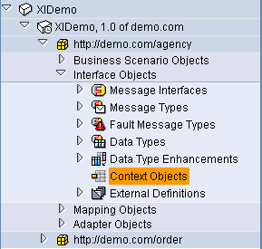
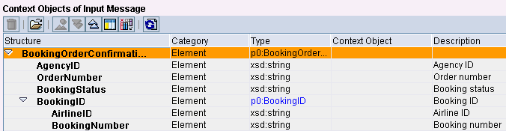
Interface Objects: Context Objects
Context Object
Pointer to a specific element (field) within the message, for future reference
Encapsulate access to data that is contained in the payload or in the header (technical context objects) of a message
Example: in CREMAS03 (Vendor master) IDoc:
zipcode = CREMAS03/IDOC/E1LFA1M/PSTLZ
1. Create Context Object
2. Use Context Object
in Service Interface
Notes:
In the navigation tree of the Enterprise Service Repository the new object “Context Object“ can be found under Software Component -> Software Component Version -> Namespace -> Interface objects -> Context Objects
Details of Step 1 – Create Context Object:
Name/ namespace/ software component version (like all other repository objects)
Type (xsd:string/ xsd:int/ xsd:date/ xsd:time) – determines the “comparison type“ (lexicographically, number, date, time)
Details of Step 2 – Use Context Object in Service Interface:
Context objects are assigned to a certain position in the Service Interface

Slide 6
Enterprise Service Repository
Agenda
Advanced Mapping Objects - Standard functions
Context Objects
UDF

Slide 7
User Defined Function
If the existing standard functions do not fulfill the requirements for your mapping, you can create your own user-defined functions in the mapping editor.
As of SAP NW PI 7.1, users can define global functions in addition to local functions, which can only be used in the message mapping in which they were defined.
Global functions are created in function libraries, which in turn, can be included in various message mappings.
Once the function is created, you can use it in the data-flow editor in the same way you would use a standard function. Your function is then displayed in the User-Defined area in the list of standard functions.
Notes:
To create a user-defined function, choose the arrow beside the icon with the quick info text Create New Function, which is located in the lower toolbar in the data-flow editor.
The function parameters such as the name, title, description, and execution type must be entered first.
The function name is the technical name (name of the Java method). The title is the name of the function in the data-flow editor. The execution type controls how the function behaves during mapping.
You can then define the number, names, and types of function transfer arguments in the Signature Variables area. When you choose Create Function, a small editor window appears in which you use Java statements to program the function.

Slide 8
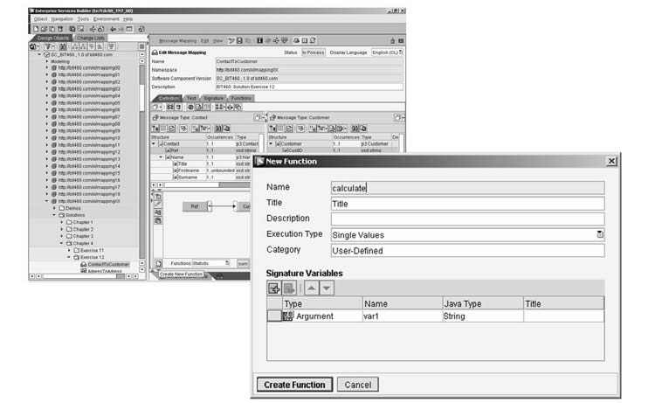
User Defined Function

